Slide 1
Section 1.4
Infinitesimal and Infinite Quantities

Slide 2
Infinitesimal Quantities [无穷小量]
Definition
If a function
as
(or
) then
is called
an infinitesimal quantity [无穷小量] with respect to
(or
),
or is called simply
infinitesimal [无穷小].

Slide 3
Infinitesimal Quantities
Remark
Do not confuse an infinitesimal quantity with any small non-zero value.
Whether a function is an infinitesimal quantity depends also on how the independent variable changes.

Slide 4
Infinitesimal Quantities
Relation of Infinitesimals with limits
Theorem The necessary and sufficient condition for
is
, where
is infinitesimal.

Slide 5
Infinitesimal Quantities
Theorem Suppose that the independent variables change in the same way. Then
(1) The algebraic sum of a finite number of infinitesimals is still an infinitesimal;
(2)The product of a finite number of infinitesimals is also an infinitesimal.
For example
If a(x) and b(x) are two infinitesimals as x tends to x₀ , then
c(x) = a(x) + b(x) is infinitesimal as x tends to x₀;
d(x) = a(x)b(x) is infinitesimal as x tends to x₀.

Slide 6
Infinitesimal Quantities
Theorem Suppose that
is an infinitesimal as
and
f (x) is a locally bounded function in the deleted neighborhood of
Then
is also an infinitesimal as
Example Find
f (x) is locally bounded function
is an infinitesimal

Slide 7
Infinitesimal Quantities
The sum or product of two infinitesimal is still an infinitesimal , then how about the quotient of two infinitesimals? Is it also an infinitesimal?
For example, as
x, sin x and x² are both infinitesimals.
We have

Slide 8
The order of Infinitesimals
Definition (The Order of the Infinitesimals ) Assume that
and
are two infinitesimals as x is varying in a
certain way, and
(1) If
then
is said to be an infinitesimal of
higher order than
(or
is infinitesimal of lower order
than
), denoted by
In particular, the notation
means
is an infinitesimal.

Slide 9
The order of Infinitesimals
Definition (The Order of the Infinitesimals ) Assume that
and
are two infinitesimals as x is varying in a
certain way, and
(2) If
, then
and
are said to
be two infinitesimals with the same order [同阶无穷小],
denoted by

Slide 10
The order of Infinitesimals
Definition (The Order of the Infinitesimals ) Assume that
and
are two infinitesimals as x is varying in a
certain way, and
(3) If
, then
and
are said to
be two equivalent infinitesimals [等价无穷小],
denoted by

Slide 11
The order of Infinitesimals
Definition (The Order of the Infinitesimals ) Assume that
and
are two infinitesimals as x is varying in a
certain way, and
(4) If
then
is said to be a
k-order infinitesimal with respect to

Slide 12
The order of Infinitesimals
Example
Compare the orders for the following infinitesimals as
(1)
Solution
Since
we have
(2)
Solution
Since
we have
Similarly, it is easy to check that when
, we have
.

Slide 13
The order of Infinitesimals
Example Prove that when
Proof:
By the formula
Rationalizing the numerator we obtain
Hence
Finish.

Slide 14
Equivalence transformations of infinitesimals
Theorem Suppose that
,
,
,
are all infinitesimals
for a given behaviors of x.
If
and the limit of
exists.
Then the limit of
also exists and
Proof
Since
the conclusion follows from our assumptions.

Slide 15
Equivalence transformations of infinitesimals
Example Find
Solution
Since we have known that
and
we have
Finish.

Slide 16
Equivalence transformations of infinitesimals
Example Find
Solution
Finish.
Note: Misuse of the theorem:
×
.

Slide 17
Infinite quantities

Slide 18
Infinite quantities
Geometric meaning of an infinite quantity

Slide 19
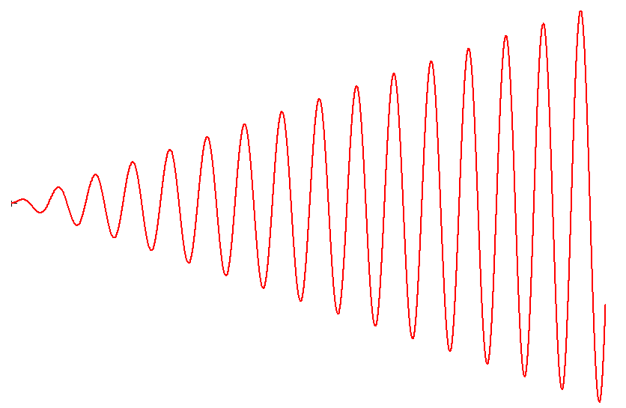
Infinite quantities
Example
Example
y
unbounded
is not an infinity as
o
x

Slide 20
Infinite quantities
(3) The product of a finite number of infinities is also an infinity;
(4) The sum of an infinity and bounded function is also an infinity.
Note The algebraic sum of two infinities is not necessarily an infinity and the product of an infinity and a bounded function is also not necessarily an infinity.

Slide 21
Review
The definition of infinitesimal and their order
Equivalence transformations of infinitesimals
Infinite quantities

Slide 22
Section 1.5
Continuous Functions

Slide 23

Continuous Function [连续函数] and Discontinuous Points [间断点]
Definition Consider a function
We say f (x) is
continuous [连续] at x₀ if and only if
(1) f (x) is well defined;
(2)
Otherwise, we say f (x) is discontinuous [间断] at x₀ .
Another way to express the definition of continuity at x₀ is:

Slide 24
The Continuity of Function
Suppose that a function y = f (x)
is defined in
When the
independent variable changes from x₀ to x, the corresponding
functional value will be changed from f (x₀ ) to f (x). Then
Y
is called the increment of the independent
variable[自变量增量], and
f (x)
is called the increment of the functional value [函数值增量], or simply the increment of the function [函数增量].
f (x₀)
x₀
x
X
Notes:
Continuity.

Slide 25
The Continuity of Function
f (x) is continuous at x₀.
(1) f (x) is well defined;
(2)
f (x) is continuous [连续] at x₀ if and only if

Slide 26
The Continuity of Function
Definition (Left and right side continuity) Let x₀ D(f), we say f (x) is left continuous [左连续] at x₀ if
and f (x) is right continuous [右连续] at x₀ if
Theorem
Suppose that a function y = f (x)
is defined in
then

Slide 27
The Continuity of Function
Note If f (x) is continuous at every point of an open interval
(a, b) then f (x) is said to be continuous in the interval (a, b);
if f (x) is continuous in the open interval (a, b) and is continuous from the right at point x = a and is also continuous from the left at x = b, then f (x) is said to be continuous on the closed interval [a, b];
if f (x) is continuous in an interval I, then it is called a continuous function in this interval I;
if I is just the domain of definition of this function then f (x)
is called a continuous function.

Slide 28
The Continuity of Function
The graph of a continuous function is a continuous curve.
Note We use the symbol
to express the set of all
continuous functions in the interval
, that is

Slide 29
The Continuity of Function
Example Prove
Proof:
For any
by a trigonometric identity we have
then
.
Hence
is continuous at
Since,
is arbitrary point
in the interval
we have
.
Finish.

Slide 30
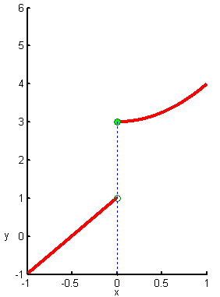
The Continuity of Function
Example Prove
does not continuous at
.
Proof
Since
and
we have the conclusion.
Finish.

Slide 31
The Classification of Discontinuous Points
If a function is continuous at x = x₀ , then it must satisfy all of the following three conditions:
is defined at
;
exists, that is,
and
both exist
and are equal;
.
Hence, if any one of these conditions is not satisfied then the function f is discontinuous at x₀.
A point at which a function is discontinuous is called a discontinuous point[间断点] of the function or point of discontinuity of the function.
Notes:
Discontinuity.

Slide 32
The Classification of Discontinuous Points
The discontinuous points of function can be divided into two types:
If the left-side limit and right-side limit of a function
at
both exist,
then
is called a discontinuity of the first
kind [第一类间断点] of the function;
all other discontinuous
points are called discontinuity of the second kind[第二类间断点].
First kind
Second Kind
Notes:
Discontinuity.

Slide 33
The Classification of Discontinuous Points
Example Consider the continuity of the sign function at x = 0.
Solution:
Since
and
jump discontinuous point [跳跃间断点]
we have
is a discontinuity of the
first kind of the sign function.

Slide 34

The Classification of Discontinuous Points
Example Consider the continuity of the function at x = 0.
Solution:
Although
the function is not defined at the point
x = 0.
Thus
is a discontinuous point of the first kind.
y
1
removable discontinuous point [可去间断点]
-1
O
1
x

Slide 35
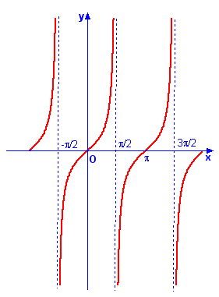
The Classification of Discontinuous Points
Example Consider the continuity of the function at
Solution:
Since
is a discontinuous point of the second kind.
infinite discontinuous point[无穷间断点]

Slide 36
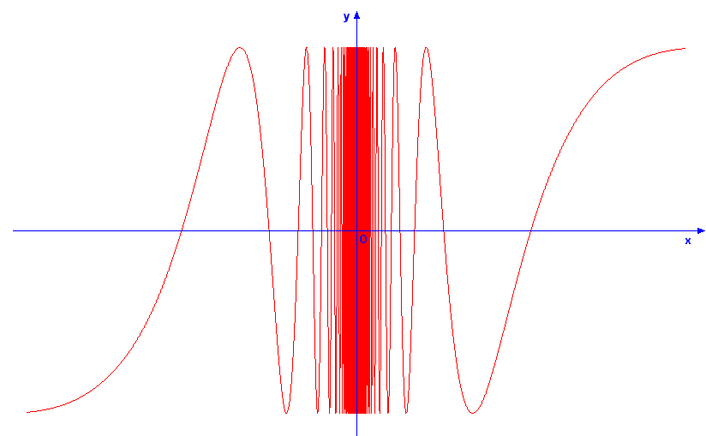
The Classification of Discontinuous Points
Example Consider the continuity of the function at
Solution:
is a discontinuous point of the second kind.
oscillating discontinuous point [振荡间断点]

Slide 37
Operations on continuous functions and the continuity of elementary functions
Theorem Suppose that the functions f and g are both continuous at x = x₀. Then
(1)
,
,
(
) are also continuous at
;
(2)
is locally bounded at
.
Theorem Suppose that the function
is composed from the functions
and
,
If g is continuous at
,
and f is
continuous at
then
is continuous at
.

Slide 38
Operations on continuous functions and the continuity of elementary functions

Slide 39
Operations on continuous functions and the continuity of elementary functions
Example Prove the continuity of the trigonometric functions.
Example Prove the continuity of the inverse trigonometric functions.
Example Prove the continuity of the exponential function.
Example Prove the continuity of the logarithmic function.
Example Prove the continuity of the power function.
All the elementary functions are continuous in their domains.

Slide 40
Operations on continuous functions and the continuity of elementary functions
Note By the definition of continuity and the composite operation rule we have
Therefore, when we calculate the limit of a continuous function, the order of the operations between the limit and evaluation of the function may be interchanged.

Slide 41
Operations on continuous functions and the continuity of elementary functions
Example Prove
Proof:
Since
can be thought of a composite function by
and
.
By the continuity of
and the composite operation rule for the limit
we have

Slide 42
Operations on continuous functions and the continuity of elementary functions
Example Prove
Proof:
Let
, then
, and
as
,
By the composite operation rule and
we obtain

Slide 43
Operations on continuous functions and the continuity of elementary functions
Example Prove
, where
Proof:
Let
Then
, and
as
Hence,
So that

Slide 44
Operations on continuous functions and the continuity of elementary functions
The limit of power-exponential functions
Example Find
Solution:
Since
and
we have
Finish.

Slide 45
Operations on continuous functions and the continuity of elementary functions
Example Investigate the continuity of the function
Solution:
It is clear that
is continuous in the interval
except
and
.
For the point
,
since
is a jump discontinuous point.

Slide 46
Operations on continuous functions and the continuity of elementary functions
Example Investigate the continuity of the function
Solution: (continued)
For the point
,
since
is a discontinuous point of second kind.

Slide 47
Operations on continuous functions and the continuity of elementary functions
Example Investigate the continuity of the function
Solution: (continued)

Slide 48
Properties of continuous functions on a closed interval

Slide 49
Properties of continuous functions on a closed interval
Proof:
Since
,
we have,
,
such that
,
.
Particularly, we choose
, we obtain that
,
Again, since
, we have
.
By the last theorem, we known
,
, such that

Slide 50
Properties of continuous functions on a closed interval
Proof (continued):
If we let
then
we have
Finish.

Slide 51
Properties of continuous functions on a closed interval

Slide 52
Properties of continuous functions on a closed interval

Slide 53
Properties of continuous functions on a closed interval
Example Prove that equation
have at least a
solution smaller than 1.
Proof:
Let
, it is easy to see that this function is continuous
on closed interval
.
Since
and
, we have
By zero theorem, we have at least one point
in the interval
, such that
Thus, there exists a
such that
and this implies the statement.
Finish.

Slide 54
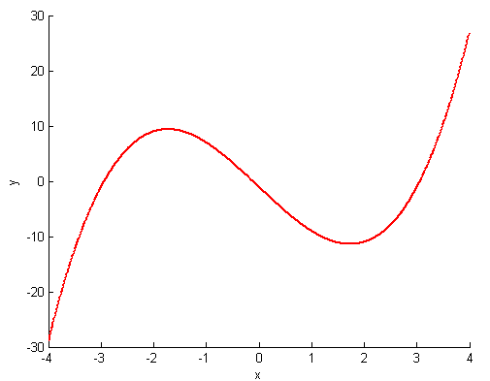
Properties of continuous functions on a closed interval
Example Prove that the three roots of the equation
are all in the interval (-4, 4).

Slide 55
Properties of continuous functions on a closed interval
Note The function must be continuous on a closed interval is necessary for the last two theorems and corollary.
Do not have maximum and
minimum values
Do not have intermediate
value

Slide 56
Properties of continuous functions on a closed interval
Example If
is continuous on
and
,
then there must exist a point
, such that
Proof:
Since
is continuous on
,
is continuous on
. By maximum and minimum theorem, there exist
such that
and

Slide 57
Properties of continuous functions on a closed interval
Example If
is continuous on
and
,
then there must exist a point
, such that
Proof (continued)
Since
By intermediate theorem, there exist a
, such that
Finish.

Slide 58
Review
The concept of continuous function
The classification of discontinuous points
Operations on continuous functions and the continuity of elementary functions
Properties of continuous functions on a closed interval

